Slide 1
Wishlist User Guide
By JR Keene
COO of REUNIONCare, Inc.

Slide 2
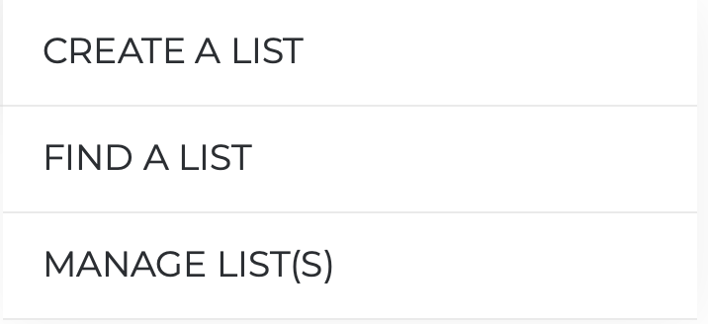
Wishlist Feature
User Guide
It’s easy to use and simple to share.
The wishlist feature is designed to allow a user to add products to a wishlist. Users will have the ability to create multiple wishlists, control the sharing visibility of those lists, and choose to share the list via Twitter, Facebook, Pinterest and Email.
2

Slide 3
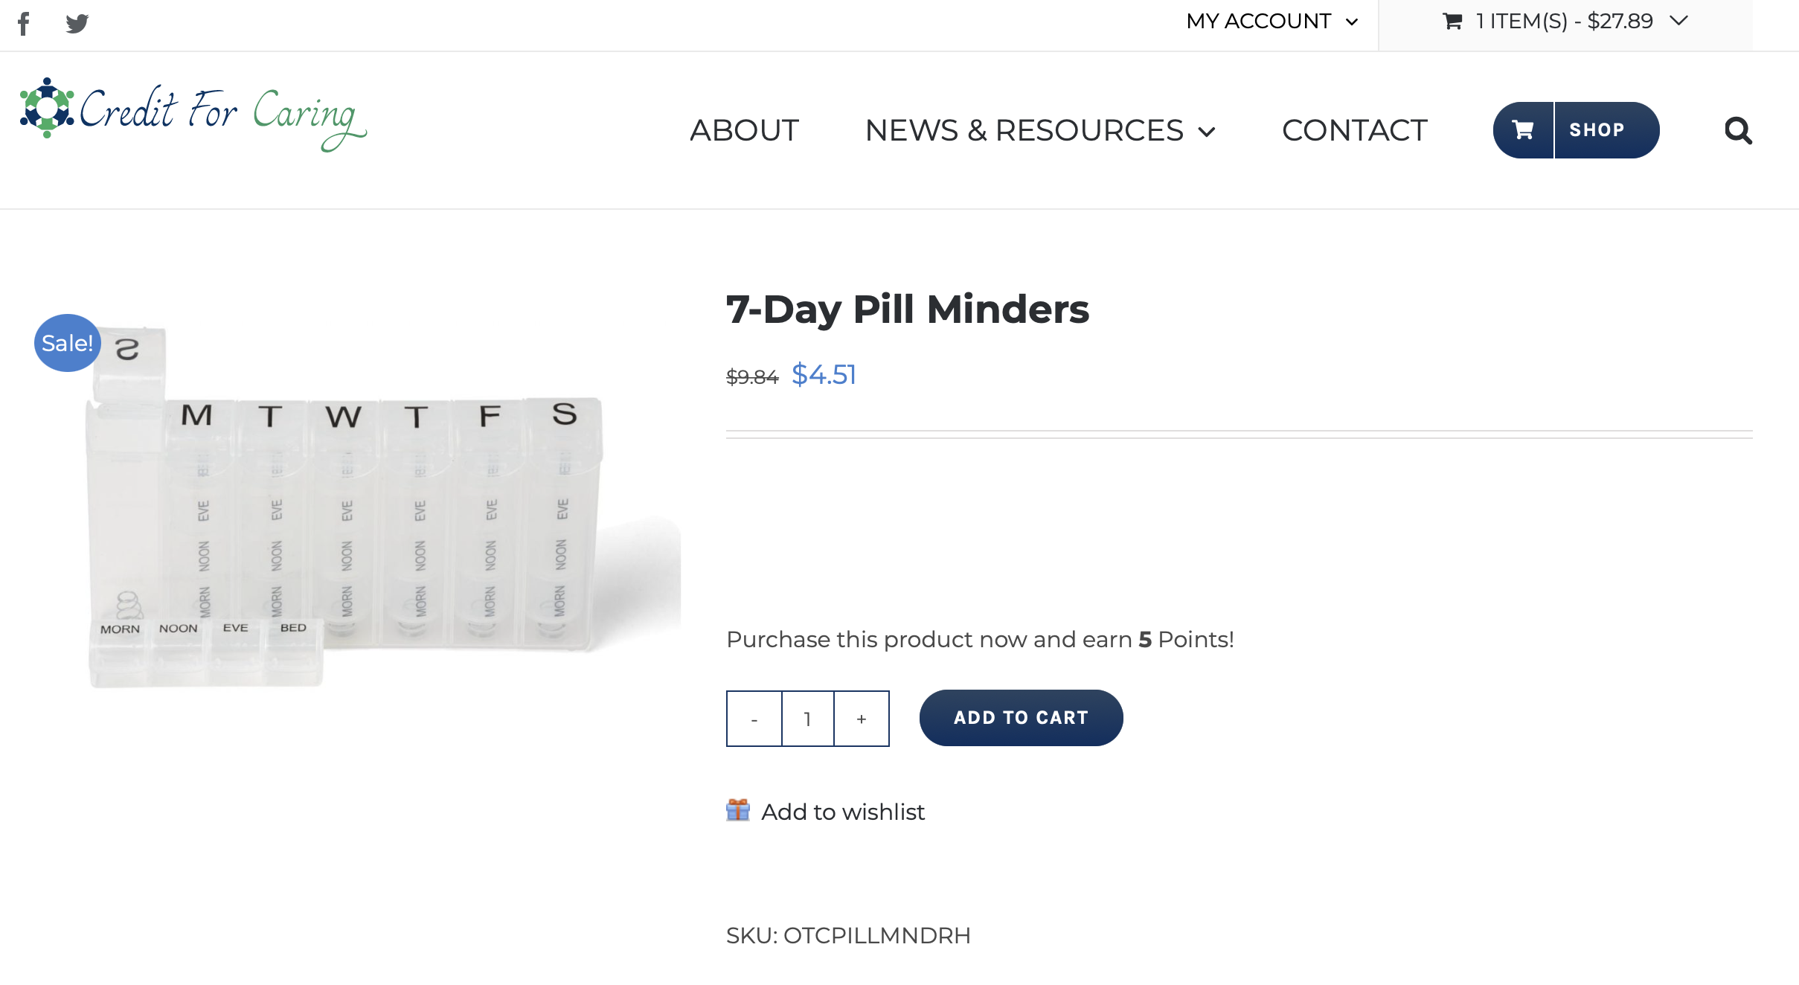
Wishlist Feature
User Guide
Adding items is
Easy
To add an item to a Wishlist, click on the provided Add to Wishlist button or link from a desired product page. If you do not have a wishlist already, one will automatically be created for you and the item will be added to it. If you already have a list, you will be shown a popup which allows you to select which list you would like to add the item to. If you want to add the item to a new Wishlist, you can choose to create a new wishlist and add the item all in one step.
3

Slide 4
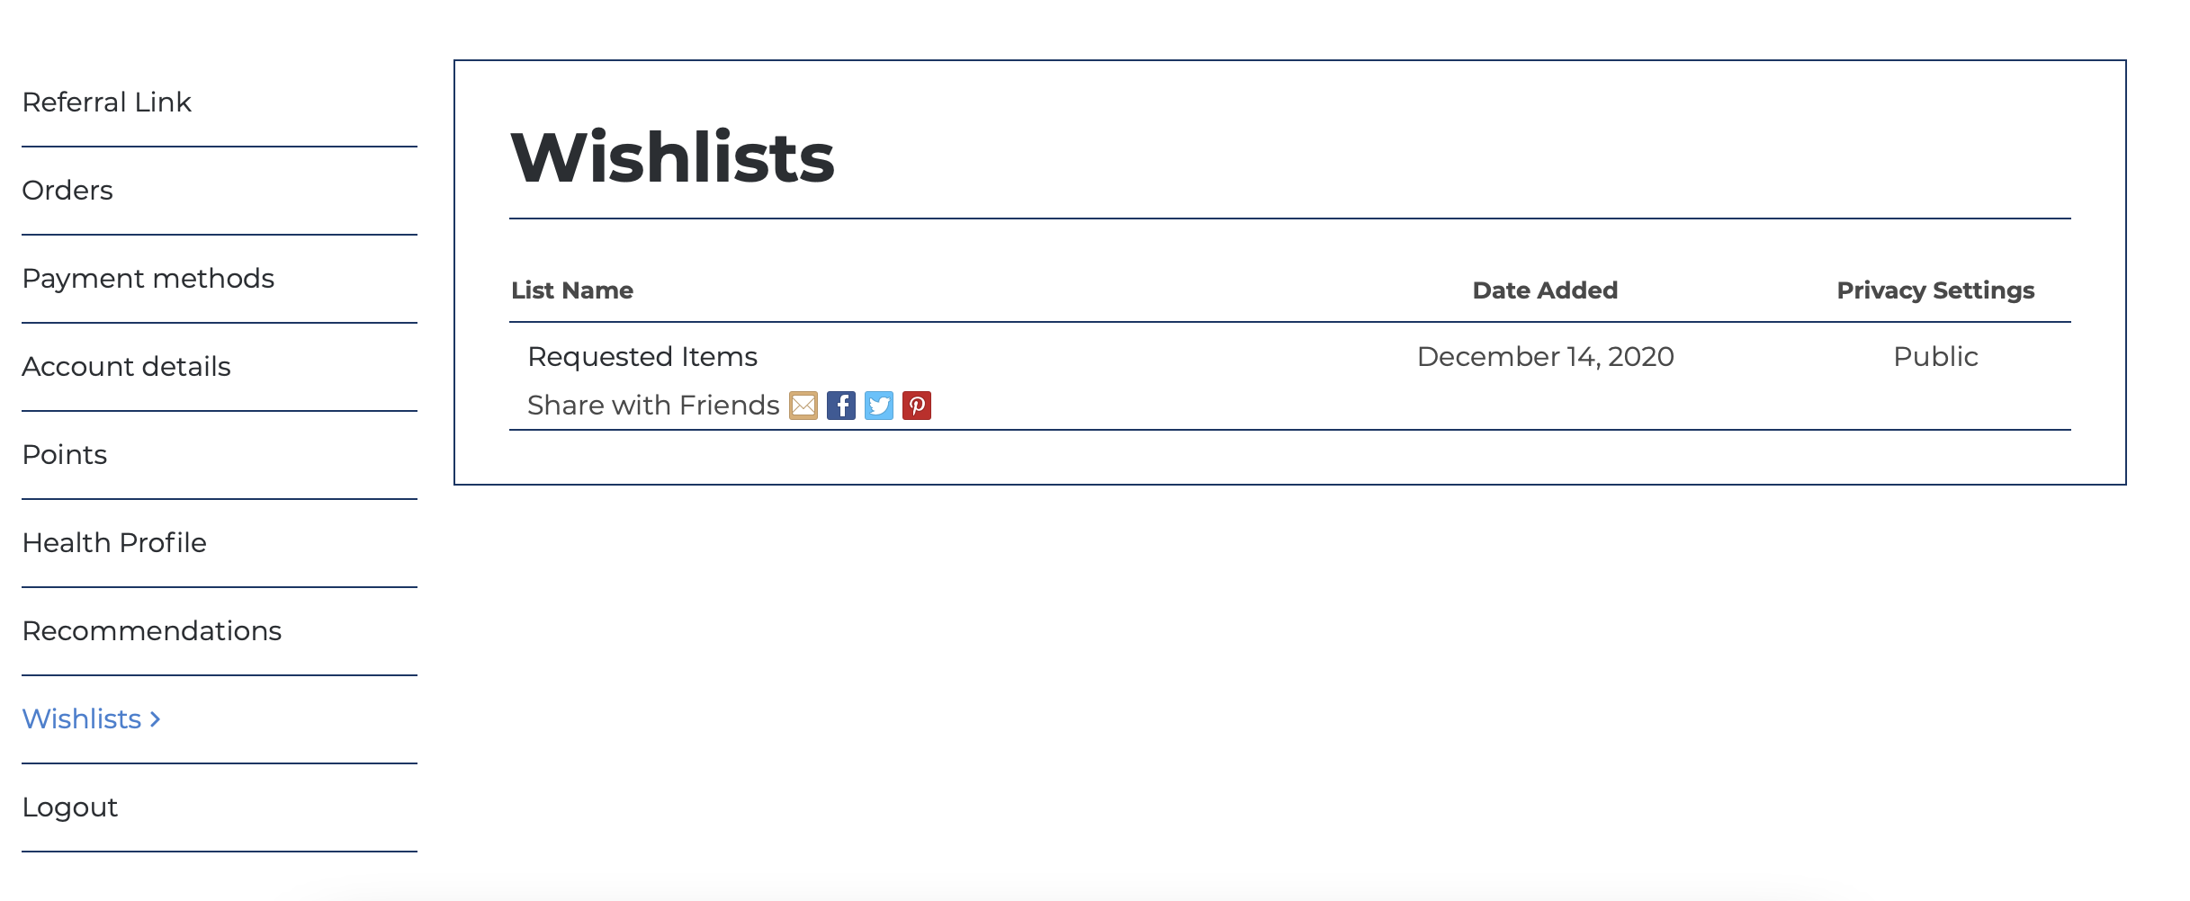
Wishlist Feature
User Guide
View, Manage & Edit
Lists
You can view and manage your lists from two different sections of the site. You can navigate to the “Wishlists” page and access all your lists. If you are logged into your account on the site, you will see the wishlists available from your “My Account” page.
To edit a list you have already created, click on the title of the list. This will bring you to the “Manage List Page”.
From this page you can view and manage the items in your list and change the sharing and basic Wishlist information.
5

Slide 5
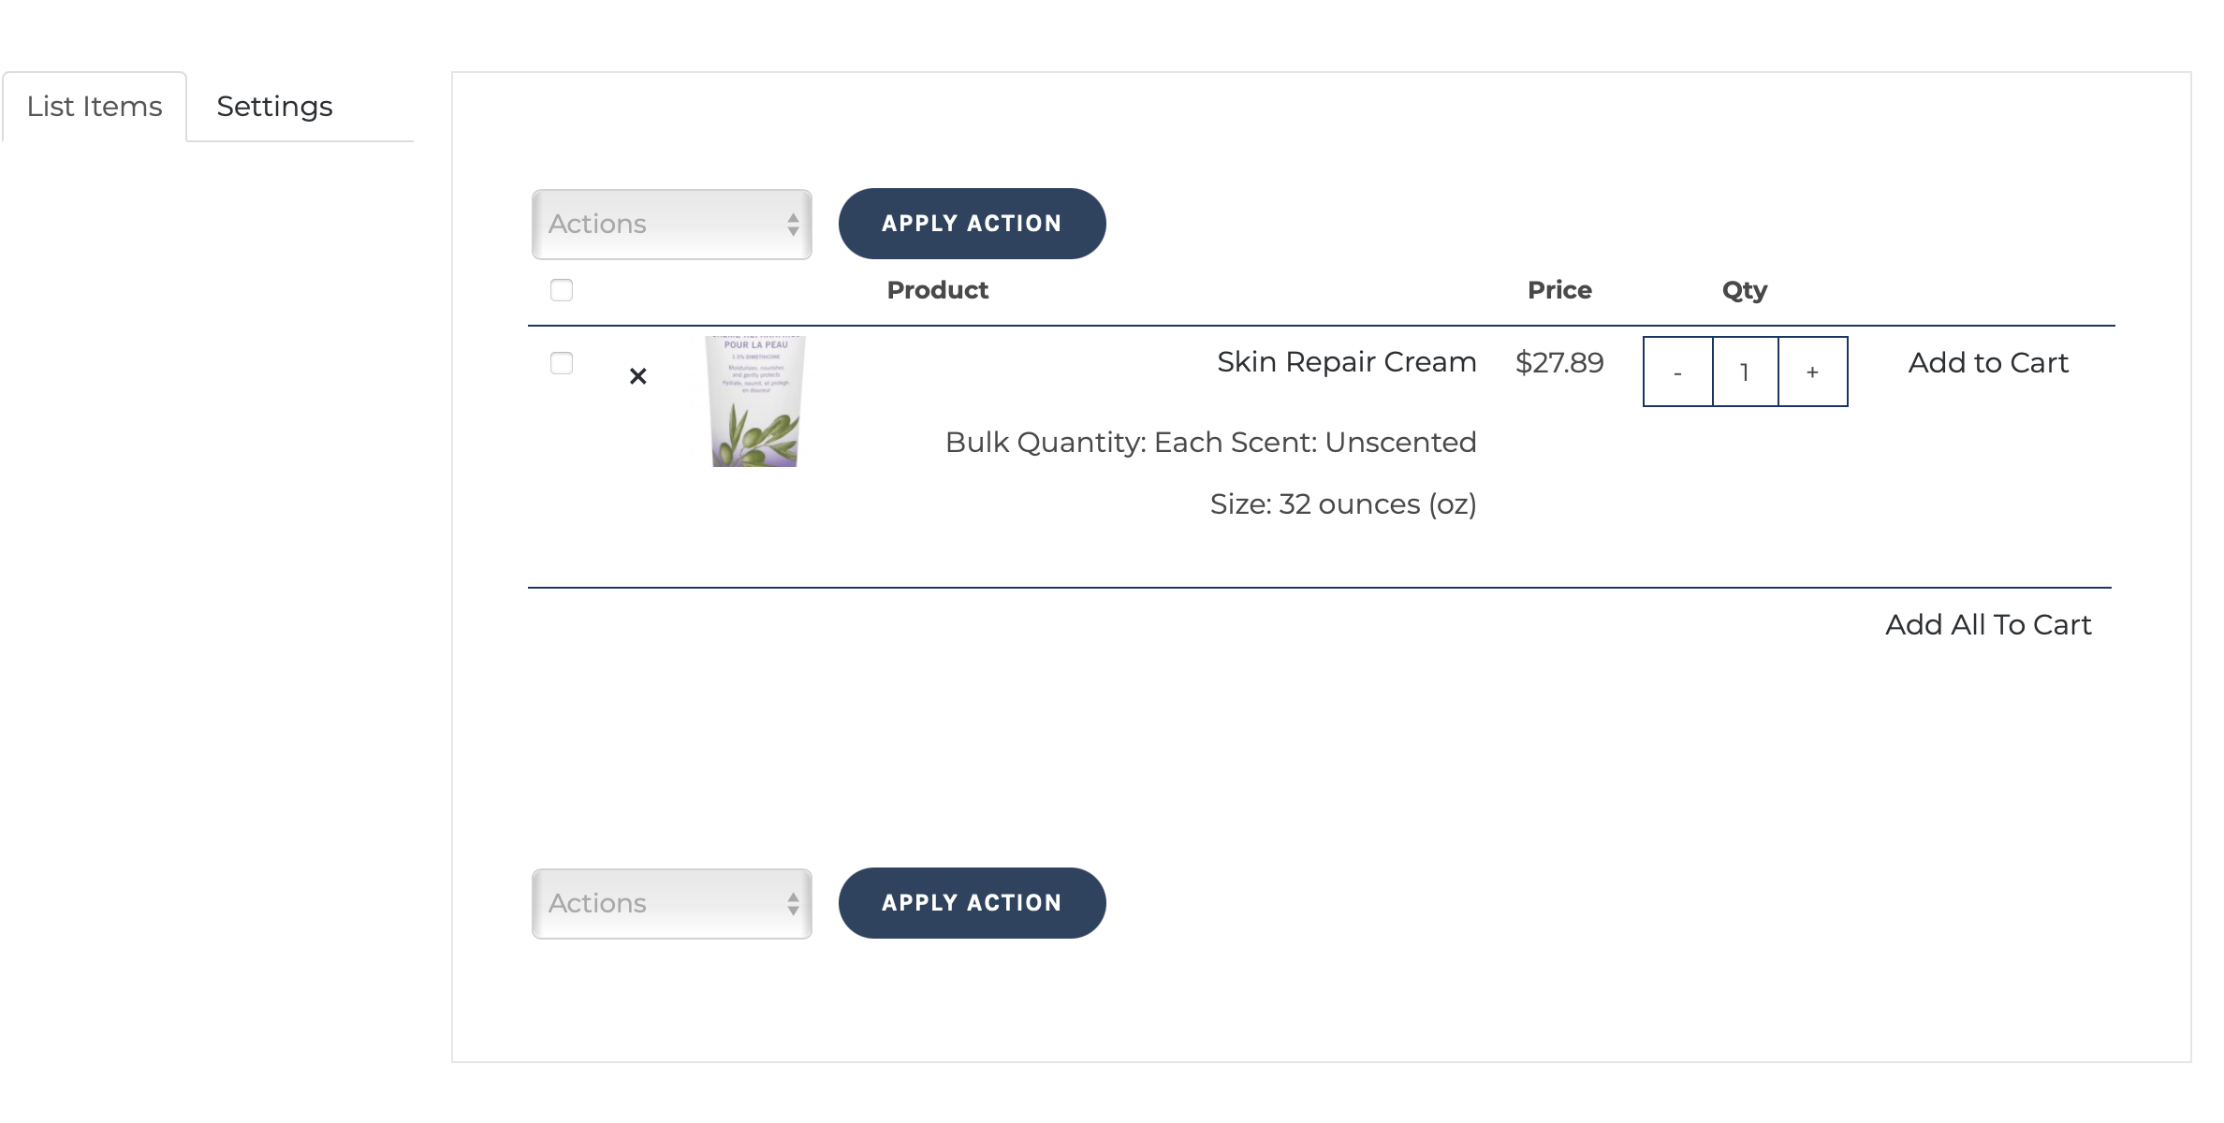
Wishlist Feature
User Guide
Edit Your List Items
On the List Items tab you will see a list of items you have previously added to your list and a set of actions you can perform on those items. To apply an action to item(s) in your list, check the item(s), select the action from the drop-down menu and click Apply Action. Your selected action will be applied to each item you selected. Check the top checkbox to select all items at once.
The actions available to you are:
• Add to Cart – Adds all the selected items to the cart.
• Update Quantities -This will update the quantities for the selected items. Be sure to change the quantity on the individual line items by adjusting the Quantity field.
• Remove From List – This will remove the selected items from your list.
• Create a New List – This action will take you to the create a list screen. After you create a new list, the items you previously selected will be added to the list and removed from the original.
5

Slide 6
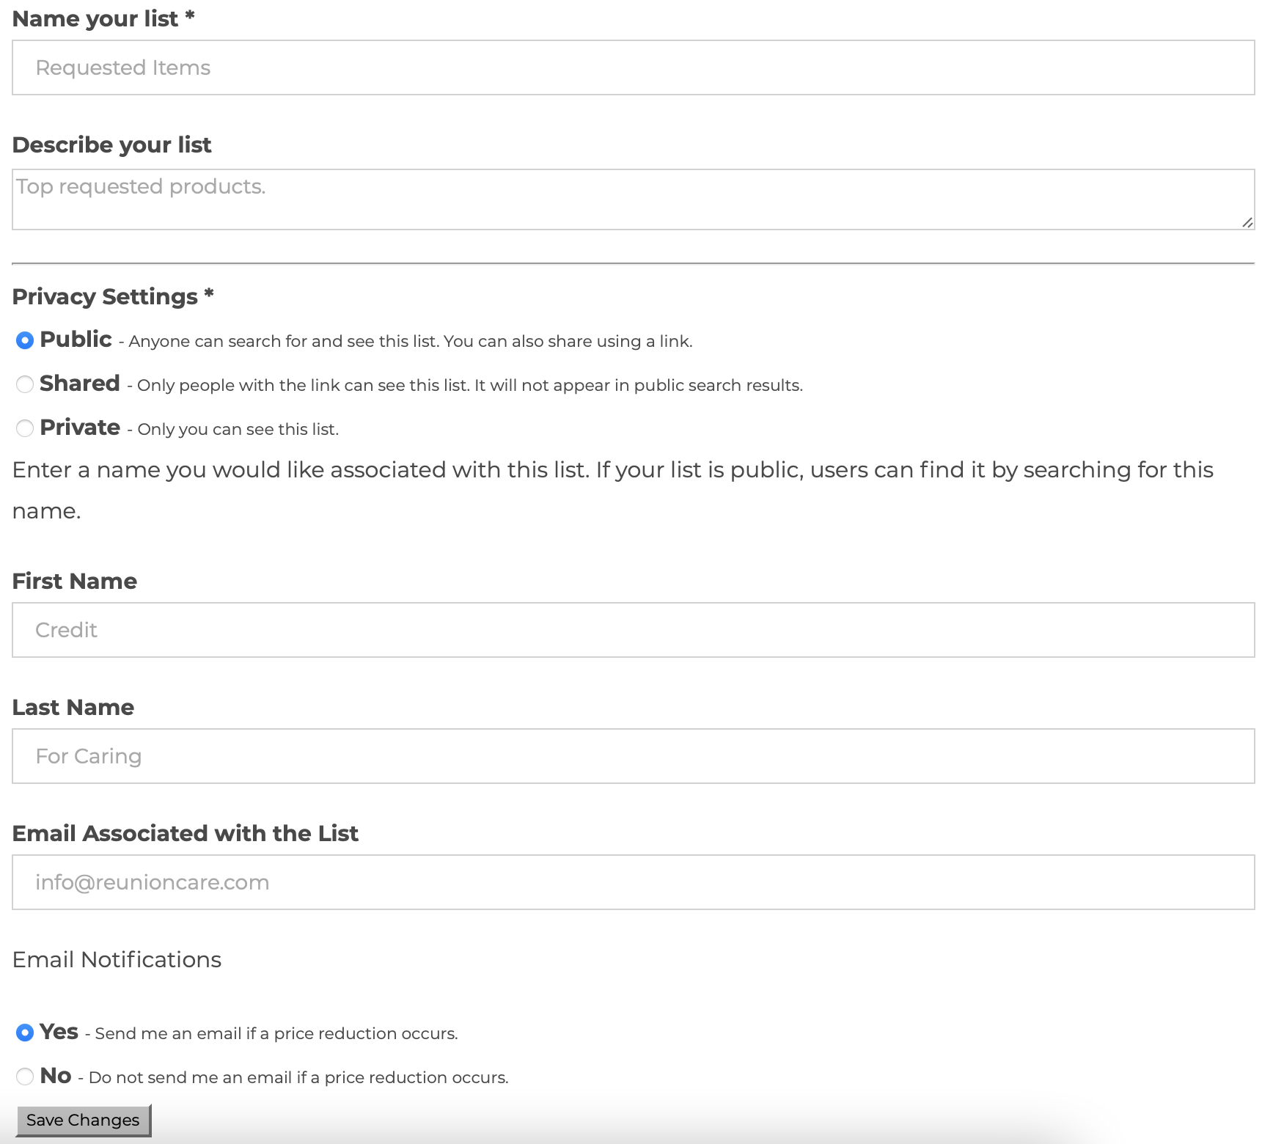
Wishlist Feature
User Guide
Edit List Settings
5

